Slide 1

Credit Card Data Analysis Report -Customer & Transaction Insights

Slide 2
TABLE OF CONTENTS
INTRODUCTION
CALCULATED FIELDS WITH DAX
CREDICT CARD INSIGHTS

Slide 3
INTRODUCTION
This presentation provides a comprehensive analysis of credit card customer behavior and transaction trends, focusing on key drivers of revenue, customer engagement, and risk management.
Using data-driven insights, the analysis explores customer segmentation, spending patterns, activation rates, and delinquency trends to identify opportunities for business growth and optimization.
The objective of this report is to:
Understand the most valuable customers.
Analyze how and where customers spend.
Evaluate financial performance and risk indicators.
Identify strategic opportunities to improve revenue and engagement.
Overall, this presentation highlights how data analytics can support smarter decision-making, enhance customer targeting, and drive sustainable business growth in the credit card industry.

Slide 4
KEY PERFORMANCE INDICATORS
Total Revenue: $55M
Total Transaction Amount: 45M
Interest Earned: 7.84M
Transactions Count: 10.1K
-Indicates strong financial performance and customer engagement

Slide 5
CALCULATED FIELDS WITH DAX

Slide 6
MEASURES
Average of Client num = AVERAGE(credit card[Client Num]).
CURRENT WEEK REVENUE = CALCULATE(SUM(credit card[Revenue]) ,
FILTER(ALL('credit card’) , credit card[WEEK NUMBER]=MAX(credit card[WEEK NUMBER]))).
PREVIOUS WEEK REVENUE = CALCULATE(SUM(credit card[Revenue]) ,
FILTER(ALL('credit card'), credit card[WEEK NUMBER]= MAX(credit card[WEEK NUMBER])-1)).
Trans Count = COUNT('credit card'[Total Trans Vol]).
WEEK_OVER_WEEK REVENUE = DIVIDE(([CURRENT WEEK REVENUE]-[PREVIOUS WEEK REVENUE]),
[PREVIOUS WEEK REVENUE])

Slide 7
CALCULATED COLUMNS
Revenue = credit card[Annua Fees] +credit card[Total Trans Amt]+credit card[Interest Earned].
WEEK NUMBER = WEEKNUM(credit card[Week Start Date]).
INCOME LEVEL = SWITCH ( TRUE(),
customer[Income]<35000 ,"LOW",
customer[Income]>=35000 && customer[Income]<70000 , "MEDIUM",
customer[Income]>=70000 && customer[Income]<100000, "HIGH",
"VERY HIGH” ).
AGE GROUP = SWITCH ( TRUE(),
customer[Customer Age]<30 , "20-30",
customer[Customer Age]>=30 && customer[Customer Age]<40 , "30-40",
customer[Customer Age]>=40 && customer[Customer Age]<50 , "40-50",
customer[Customer Age]>=50 && customer[Customer Age]<60 , "50-60",
customer[Customer Age]>=60 , "60+",
"UNKNOWN" ).

Slide 8
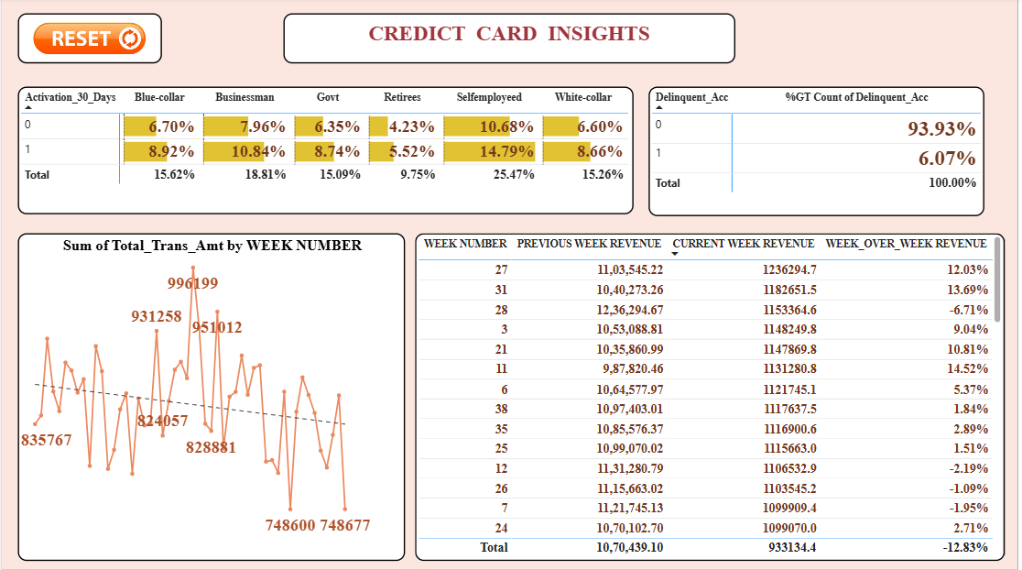

Slide 9
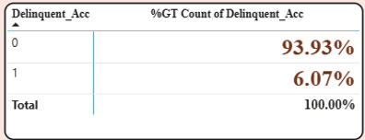
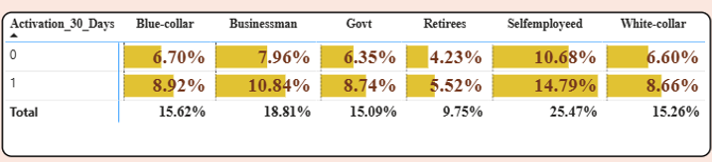
CREDICT CARD INSIGHTS
Customer Segment Contribution:
Self-employed customers contribute the highest share (~25.47%) of total accounts.
Businessmen (18.81%) and Blue-collar (15.62%) segments are also strong contributors.
Retirees (9.75%) represent the lowest share → potential growth opportunity.
Activation Behavior (30 Days):
Activation rates are higher in Self-employed (14.79%) and Businessman (10.84%) segments.
Lower activation seen in Retirees (5.52%), indicating possible engagement issues.
Overall, activation is moderate across segments, suggesting room for onboarding improvements.
Delinquency Risk:
93.93% accounts are non-delinquent, which is a strong positive indicator.
Only 6.07% are delinquent, showing:
Good credit quality
Effective risk management
However, monitoring this 6% is critical to prevent future losses.

Slide 10
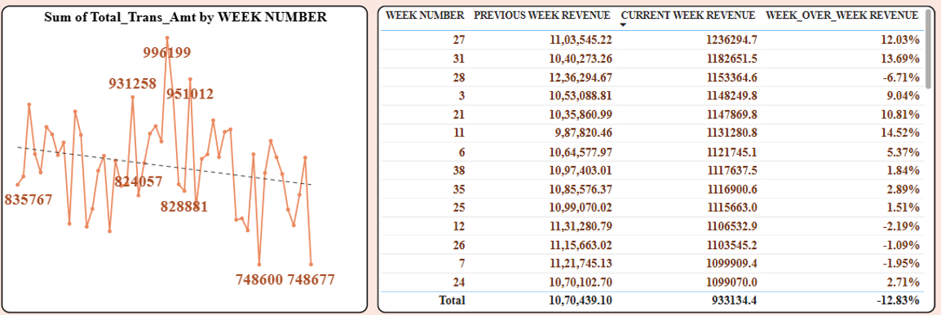
Weekly Transaction Trend:
Transaction amounts show high fluctuation across weeks.
Peak values reach around ~996K, while dips go as low as ~748K.
Slight downward trend visible → possible seasonal or behavioral impact.
Week-over-Week Revenue Performance:
Strong growth weeks:
Week 11 (+14.52%)
Week 31 (+13.69%)
Negative growth weeks:
Week 28 (-6.71%)
Week 26 & 7 (decline trend)
Overall total shows -12.83%, indicating:
Declining momentum
Need for revenue stabilization strategies

Slide 11
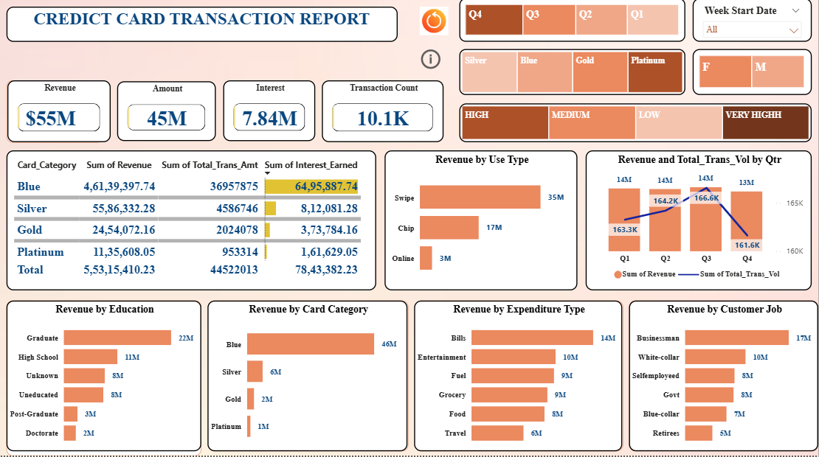

Slide 12
CREDICT CARD TRANSACTION INSIGHTS
Swipe transactions are most preferred .
Online transactions are lowest → growth opportunity
Graduates are top contributors.
Blue Card dominates revenue contribution .
Silver Card has high usage but moderate revenue.
Gold & Platinum represent premium customers .
Opportunity to upgrade customers to higher-tier cards.
Top spending categories: Bills , Entertainment , Fuel & Grocery.
Highest contributing job segments: Businessman and White-collar professionals .
Lower contribution from retirees.
Revenue peaks in Q2 and Q3 and slight drop observed in Q4. .

Slide 13
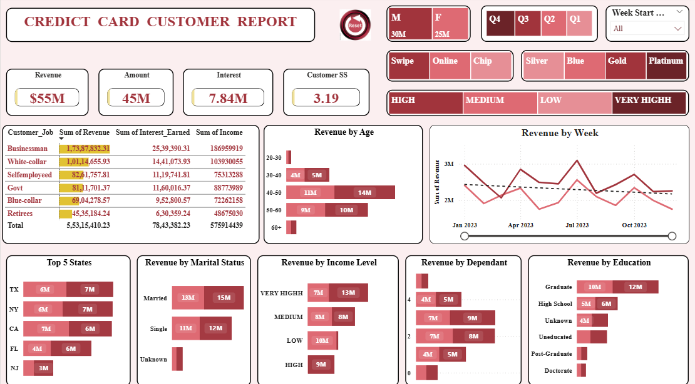

Slide 14
CUSTOMER INSIGHTS
Age group 30–50 years contributes highest revenue .
. High-income customers generate maximum value .
Married customers spend more than singles .
Customers show both essential & lifestyle spending patterns .
Top revenue states: TX, NY, CA .
Weekly trends show stable but fluctuating pattern.
Seasonal opportunities for targeted campaigns .

Slide 15
BUSINESS RECOMMENDATIONS
Promote Gold & Platinum cards for higher revenue .
Increase focus on online transactions .
Target high-income & mid-age customers .
Expand marketing in top-performing states .
Launch campaigns during low-performing periods.

Slide 16
CONCLUSION Business shows strong financial performance . Key growth lies in customer upgrade & digital adoption Data-driven strategies can further boost revenue Focus on segmentation & seasonal trends for future success

